Slide 1
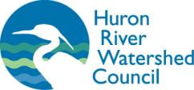
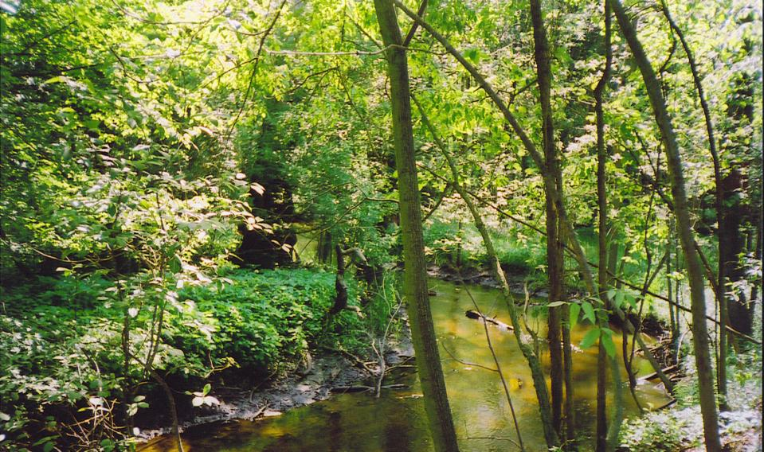
Northfield’s
Green Infrastructure
Northfield’s Landscape
Trends
What is Green Infrastructure?
Visioning
Notes:
Green infrastructure is the interconnected network of waterways, wetlands, woodlands, wildlife habitats, and other natural areas that support native species, clean water and contribute to community health and quality of life.

Slide 2
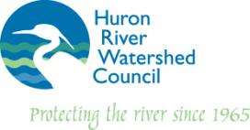
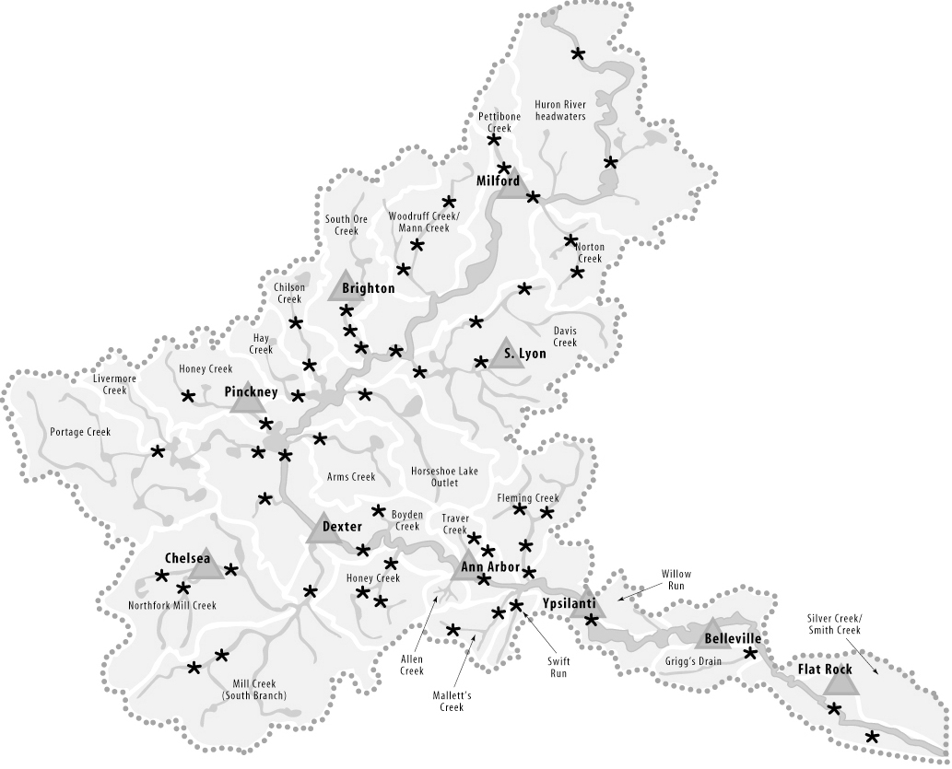
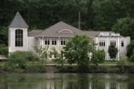
HRWC is
Michigan’s first and oldest watershed council ~ a coalition of local communities and residents established under state law in 1965 to protect
the Huron River and
its tributary streams, lakes, wetlands and groundwater.
Stockbridge
Notes:
HRWC, based in Ann Arbor, is a professional staff of 9 who work in 3 program areas: scientific research, technical assistance and education. With volunteers corps of more than 400 people. Member organization supported by member contributions, grants from foundations and federal agencies. Pitch membership

Slide 3
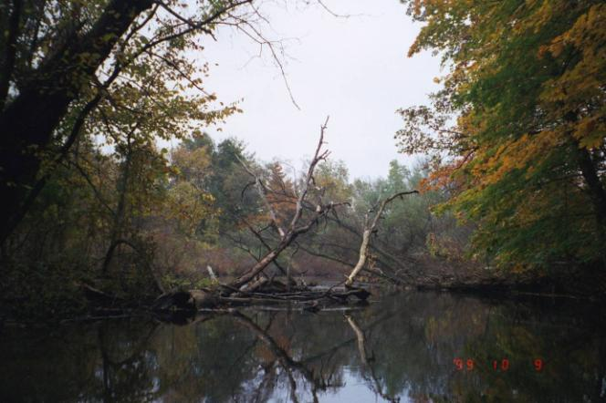
The Huron River Watershed
Green Infrastructure Services
Funding provided from the Americana Foundation

Slide 4
Northfield’s
Natural Assets

Slide 5
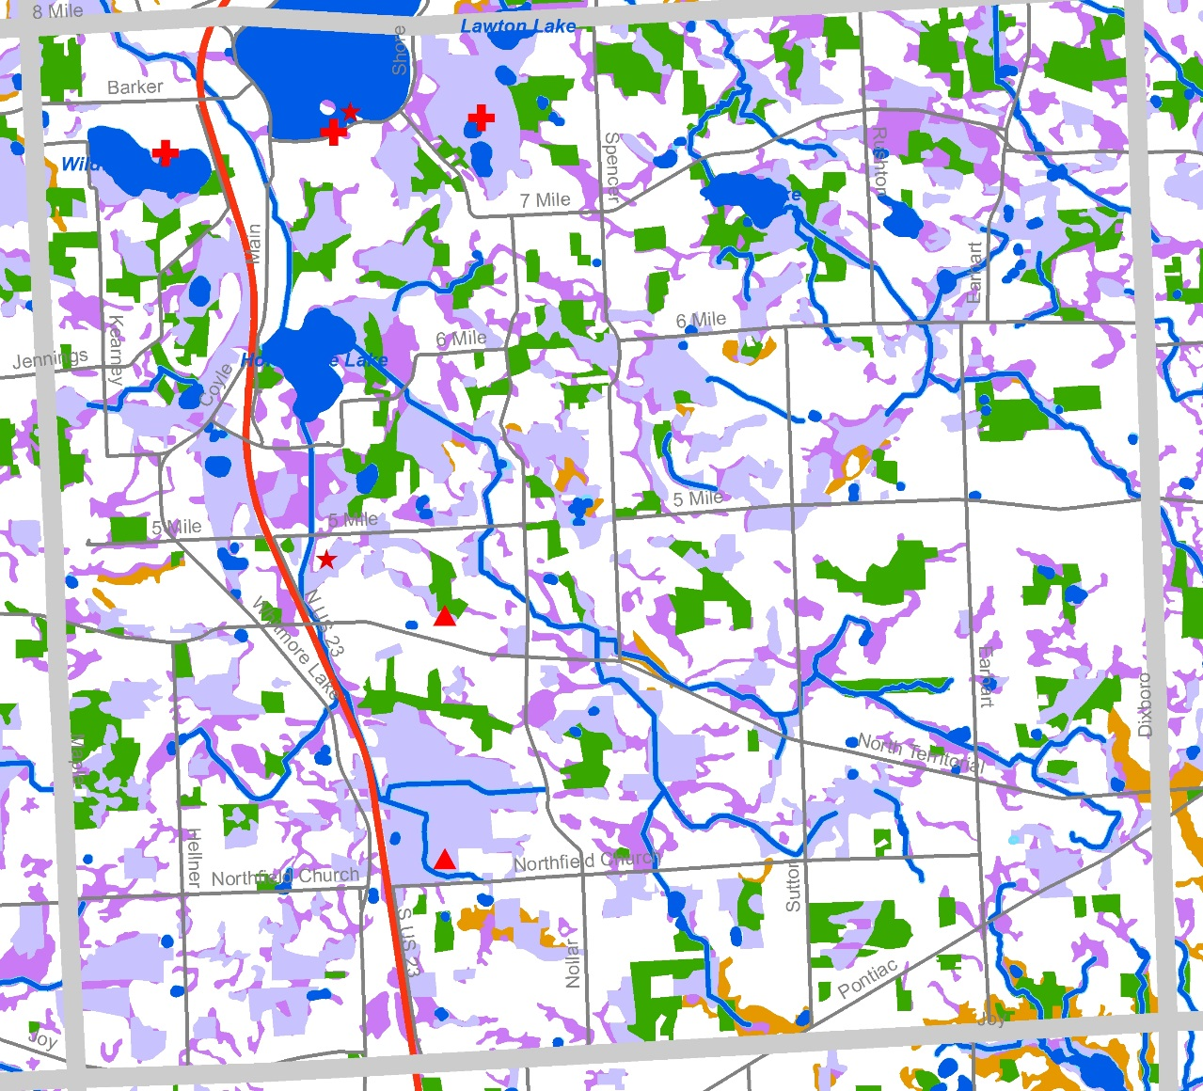
Landscape
Mostly undeveloped
31% intact natural areas (“bioreserve sites”)
Only 5 % of natural areas publicly owned)
Low impervious surface (5%)

Slide 6
Landscape of the Huron River Watershed, 1800’s
Milford
Brighton
Northfield
Chelsea
Ann Arbor
Detroit
Oak Openings
Central Hardwoods
Lowland Hardwoods
Conifers
Lowland Conifer
Upland Grassland/Herb. Shrubland
Marsh/Meadow/Prairie
Water
Shrub Wetland

Slide 7
Landscape of the Huron River Watershed, 1800’s
Oak Openings
Central Hardwoods
Conifers
Upland Grassland/
Herb. Shrubland
Water
Lowland Hardwoods
Lowland Conifer
Marsh/Meadow/Prairie
Shrub Wetland

Slide 8
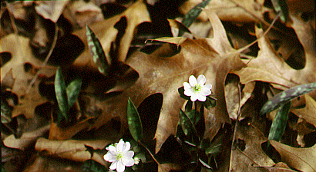
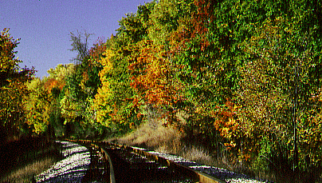
Oak/hickory forest
Photos: Ann Arbor NAP

Slide 9
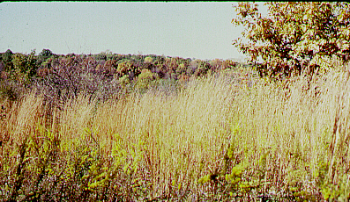
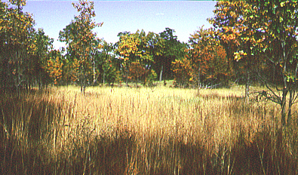
Oak savannah/barren/tallgrass praire
Photos: Ann Arbor NAP

Slide 10
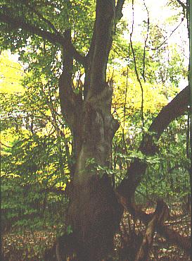
Beech/maple forest
Photo: Ann Arbor NAP

Slide 11
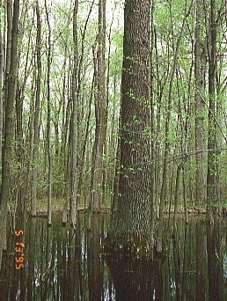
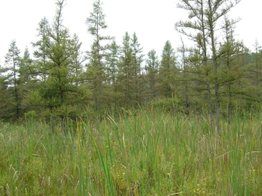
Lowland hardwood forest
Tamarack swamp
Ann Arbor NAP
Joshua G. Cohen

Slide 12
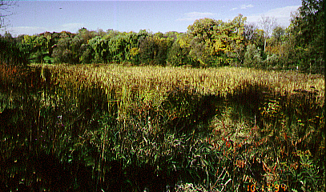
Inland wet prairie
Photo: Ann Arbor NAP

Slide 13
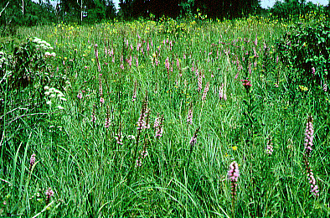
Marsh/wetland
Photo: Ann Arbor NAP

Slide 14
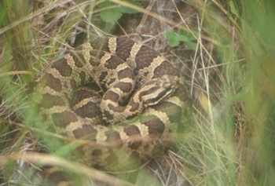
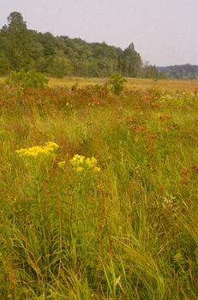
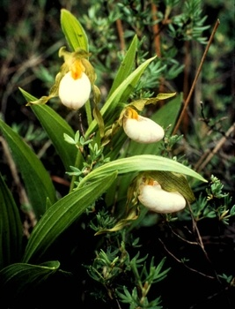
Threatened, Endangered, Special Concern:
9 animals
16 plants
1 ecosystem:
Oak barrens
Heron rookery
Massasauga
White lady slipper
Notes:
78 species, 11 plant communities, and one heron rookery listed as state threatened, endangered or of concern

Slide 15
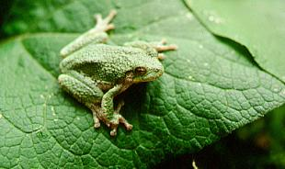
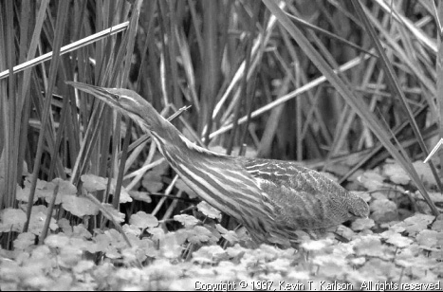
Benefits of Natural Areas
Filter & Cool Runoff
Water supply
Groundwater Recharge
Storm and flood damage protection
Erosion control
Store and cycle nutrients
Conserve and generate soils
Pollinate crops and other plants
Pest control
Forest and food products
Wildlife Habitat
Recreation
Scenery
Biodiversity/ Genetic library
Clean Air
Regulate climate
Photos: Ann Arbor NAP
Notes:
15

Slide 16
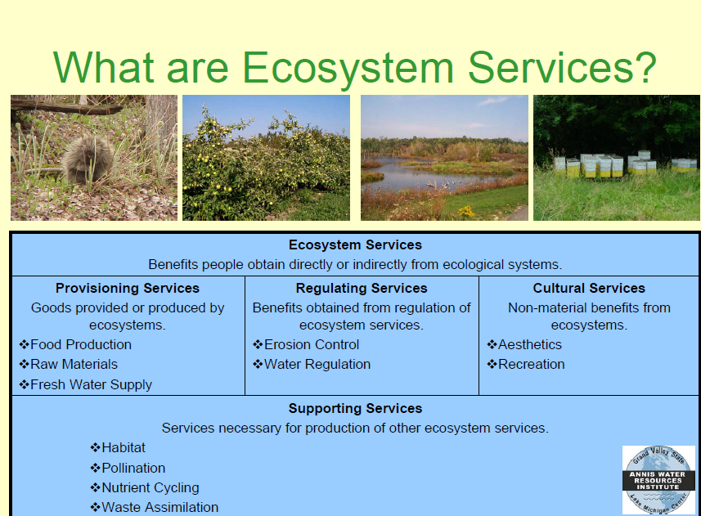
$1.8 billion/year in West Michigan
Notes:
So, Unadilla is doing great with natural lands, low impervious surface, ecosystem services. What does the future hold? What can happen to it?

Slide 17
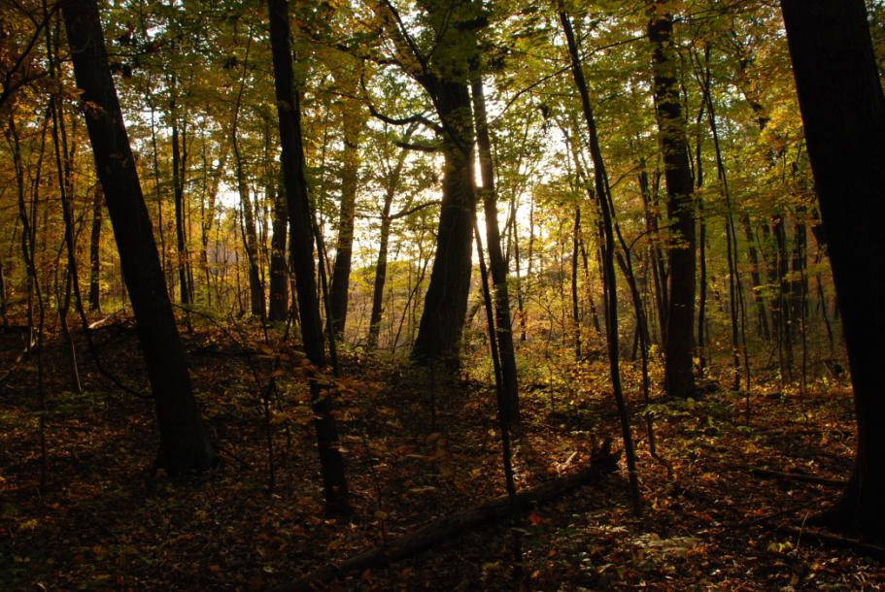
Little runoff prior to development
Water infiltrates
into humus and
porous soil
Plants take up
much water
Notes:
Very little runoff in a forest

Slide 18
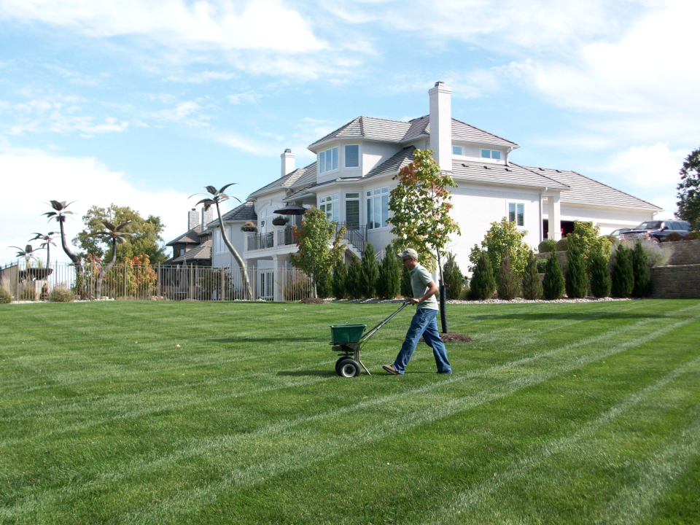
Notes:
With development we change the vegetation and topography
Which alters what water does
Topsoil removal, along with bacteria, roots, and micorrhizae
Which alters the ability to clean water

Slide 19
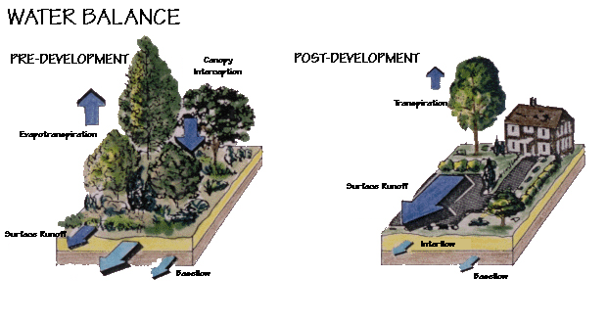
Pre-Development
Post-Development
Plants intercept the rain
Few plants,
Hard surfaces
Most rain flows THROUGH the ground.
Most rain flows OVER the ground.
Notes:
Through vs Over

Slide 20
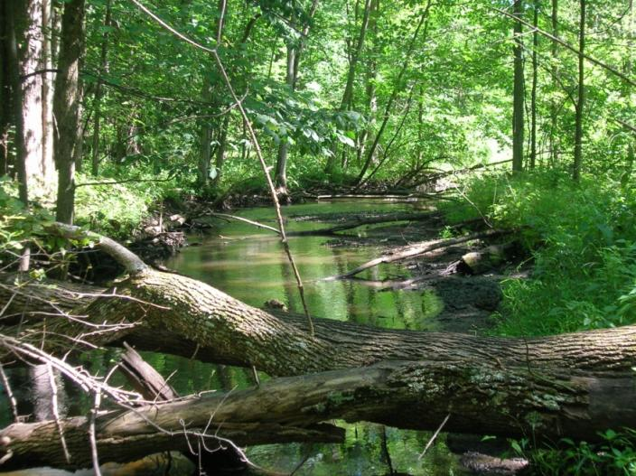
Under 10% Impervious Surface
Low banks
Natural buffer
Good habitat
Cool water
Clear water

Slide 21
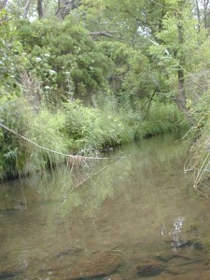
Between 10 and 25% Impervious Surface
Higher, undercut banks
sediment
Less diverse habitat
Warmer water

Slide 22
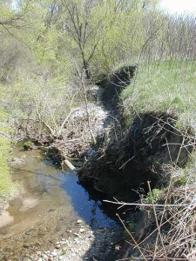
Over 25% Impervious Surface
Steep, eroded banks
Little buffer
Very little habitat
Warm water
flashy

Slide 23
Trends

Slide 24
Landscape of the Huron River Watershed, 1800’s
Oak Openings
Central Hardwoods
Conifers
Upland Grassland/
Herb. Shrubland
Water
Lowland Hardwoods
Lowland Conifer
Marsh/Meadow/Prairie
Shrub Wetland

Slide 25
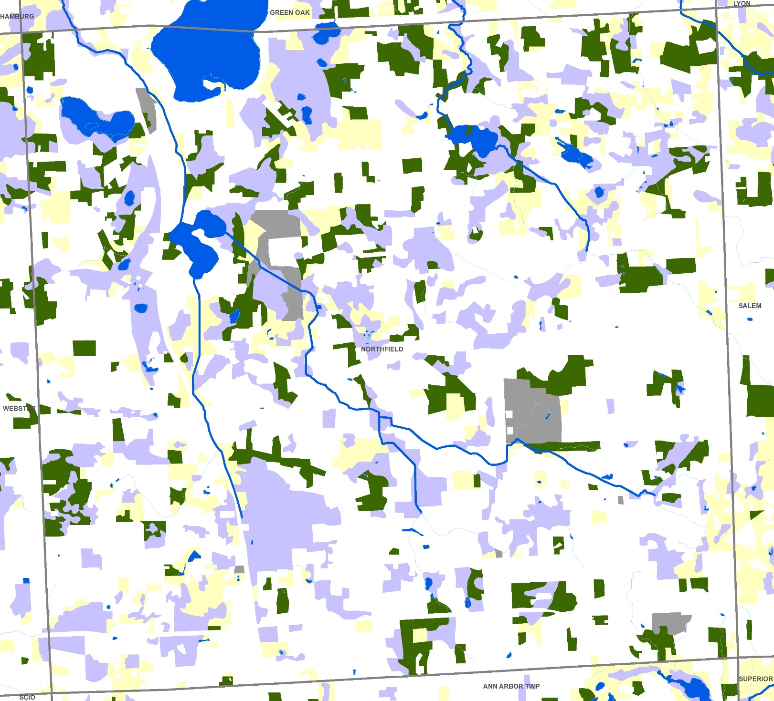
Landscape of the Huron River Watershed, 2000

Slide 26
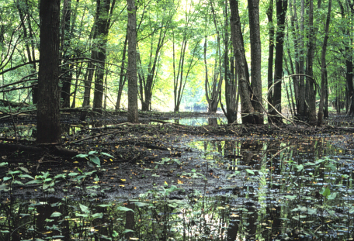
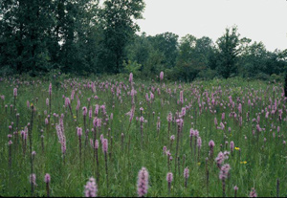
Natural area trends in the Huron
Fragmentation
Loss of wetlands (about 50%)
Loss of oak barrens, prairies, wooded wetlands, tamarack swamp

Slide 27
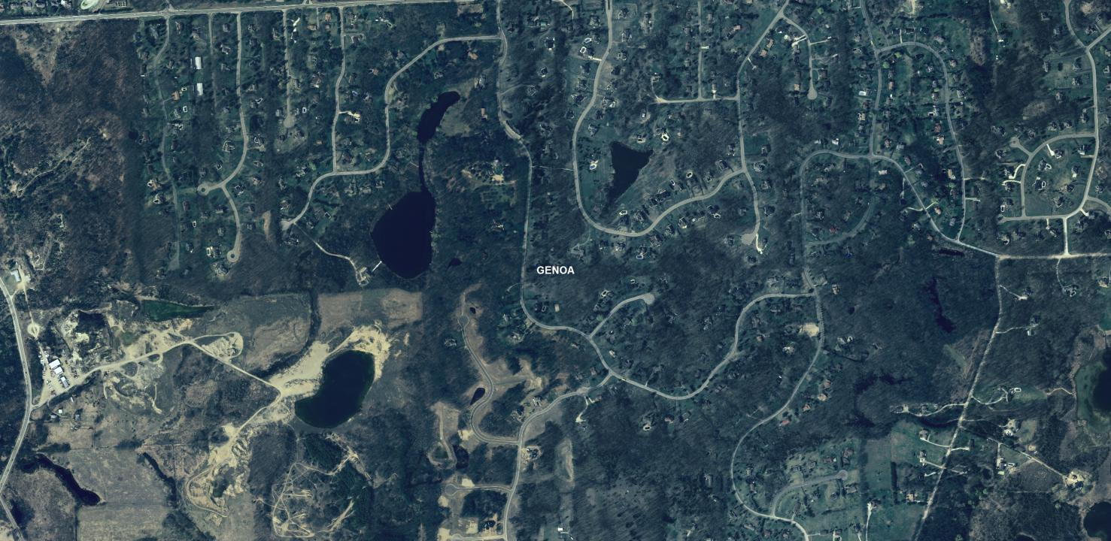
Future Trends
40% of the remaining open space is projected to be developed in the next 20 years
Master Plans and Zoning Ordinance build outs show little designated natural area
Almost all natural areas in private ownership and designated for some kind of use
Current development patterns are low density = more natural area converted per new person

Slide 28
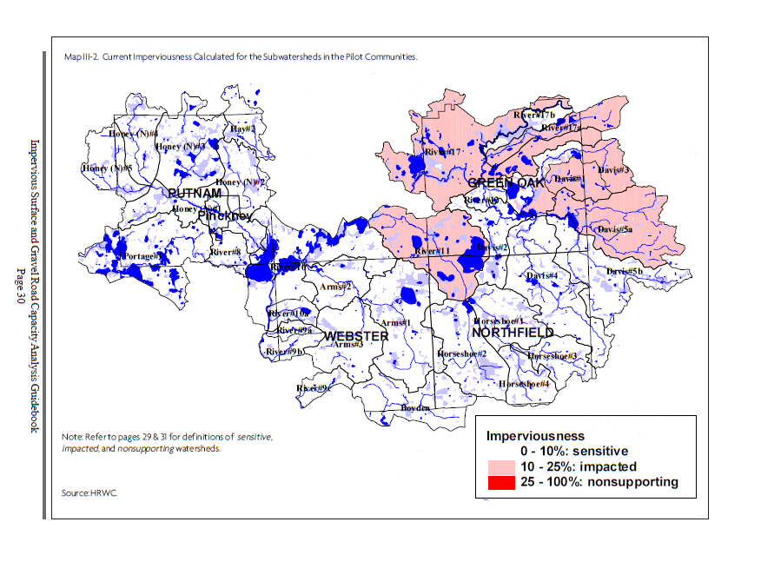

Slide 29
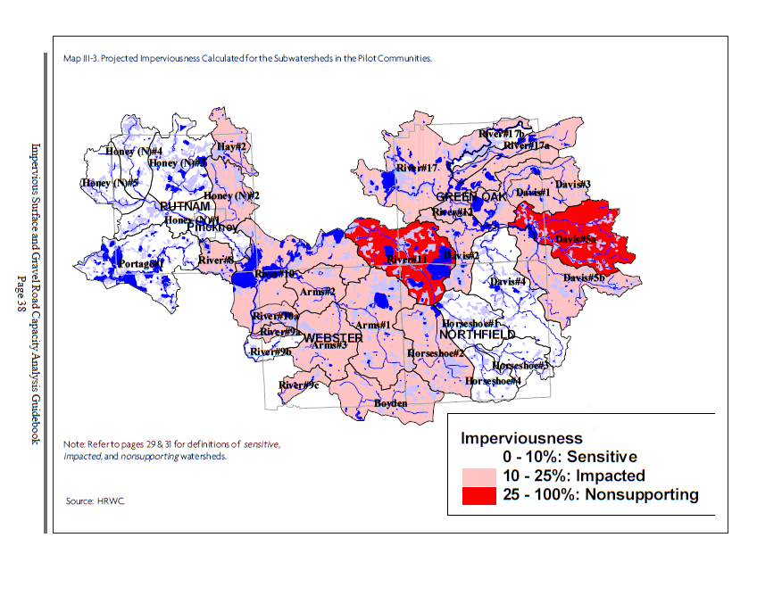
Notes:
29

Slide 30
Future
Land
Use
Downtown vision plan
Parks and Rec plan
“continued commitment to community planning goals and policies geared to
preserving important natural features, while planning for growth in those
areas most suitable for development”

Slide 31
Keeping Northfield Healthy

Slide 32
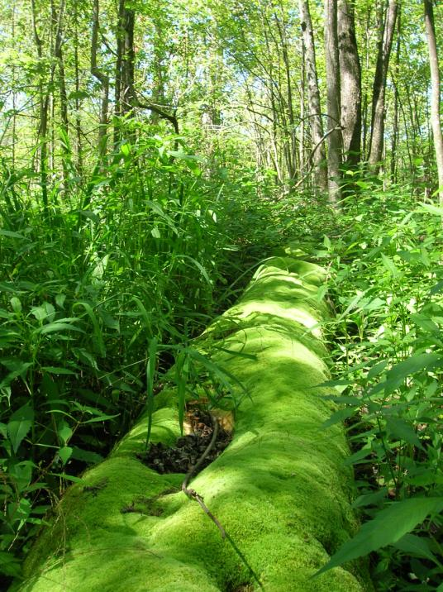
HRWC Key Message
To maintain the Huron River watershed’s health:
I. Encourage higher density where infrastructure already exists.
II. Preserve natural areas so they can continue to provide the ecological services necessary to maintain quality of water, air, land, and life.

Slide 33
The Huron River Watershed
Bioreserve Project
To assess & protect the watershed’s last
remaining natural areas
Funding provided by the Americana and Carls foundations

Slide 34
Bioreserve Map: based on aerials

Slide 35
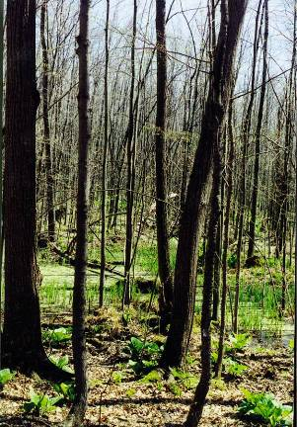
Ranked Bioreserve Sites
15 criteria
Total size
Size of core
Topographic diversity
Geological diversity
Waterway
Upland/wetland
Remnant plant community
Groundwater recharge
Connectivity
Corridors
Restorability
Amount of change since 1800
Fragmentation
MNFI “bio-rarity” index
MNFI “special” communities

Slide 36
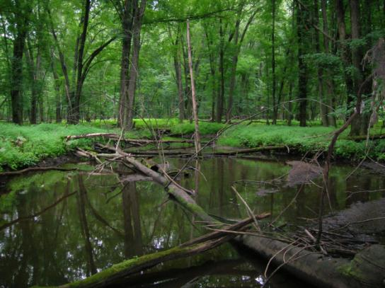
Field Assessment
Assessing ecological integrity
Ground Truth GIS map
Get more information about the natural area
Help Conservancies protect most important lands
Help with stewardship of natural lands

Slide 37
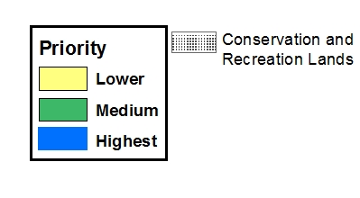
Northfield’s remaining natural areas
Field Assessments in Northfield
Doing assessments this summer

Slide 38
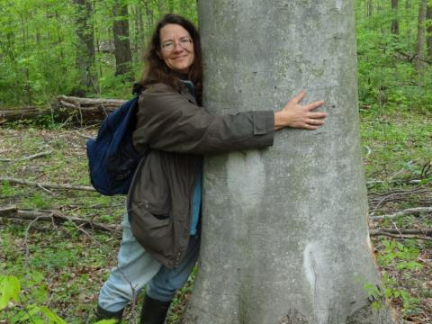
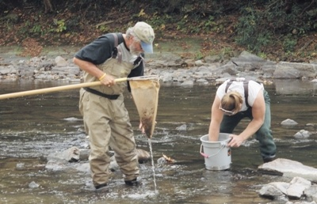
What you can do
Design higher density, livable neighborhoods
Live in a walkable community
Plant trees, native plants in your lawn
Keep water on your land
Control stormwater runoff
Leave natural buffers around creeks, wetlands, and ponds
Keep natural lands natural
Permanently preserve larger, intact, natural lands
Join us in assessing the creek and its landscapes

Slide 39
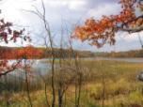

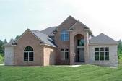
What is Green Infrastructure?
Green infrastructure is the interconnected network of open spaces, natural areas and waterways
Focusing on conservation values and the services provided by natural systems in concert with, instead of in opposition to, land development
Gives us an opportunity to Identify, Protect & Enhance our Natural Assets
Natural
Built
Notes:
In 2009 Oakland County completed a nationally-recognized Green Infrastructure Vision that identifies habitat “hubs”, “sites” and “corridors” that are important to the sustainability of Oakland County’s environmental quality, ecological diversity and economy. The multi-scale Vision not only provides a basis for the overall interconnected system of open spaces and recreation, but encourages the integration of best land management practices into the local project design.
Note:
The Conservation Fund, a national nonprofit dedicated to conservation, selected Oakland County’s vision for its National Green Infrastructure Implementation Award in February, 2011
Oakland County Economic Development & Community Affairs provides Green Infrastructure capacity building assistance to local governments, businesses, work groups, and individual citizens in both urban and rural areas.

Slide 40
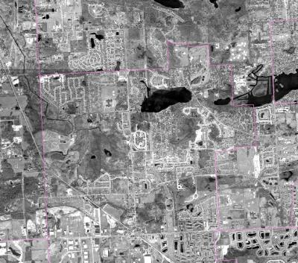
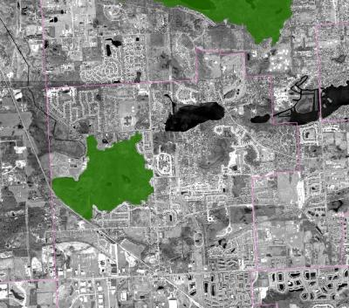
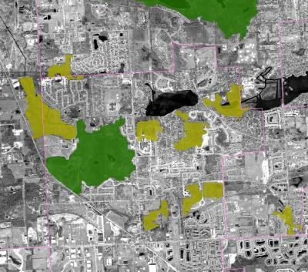
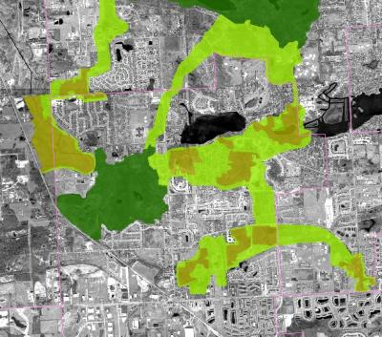
GI Background
Green infrastructure networks
consist of the following components:
Sites
Hub
Link
Hubs: Hubs anchor the network
and provide an origin or destination
for wildlife.
Hub
Sites: Smaller ecological landscape
features that can serve as a point of
origin or destination
Links: The connections that hold
the network together and enable it
to function. Links facilitate movement
from one hub to another.

Slide 41
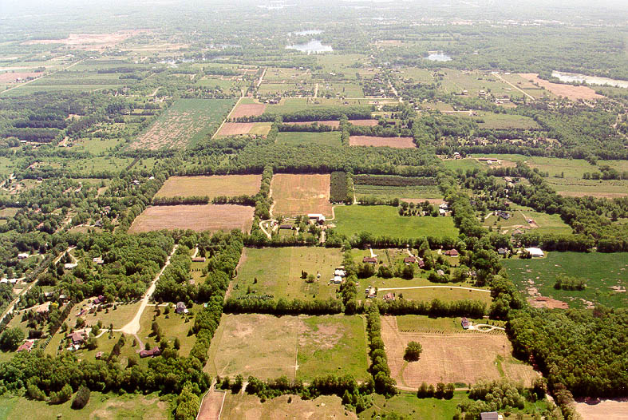
Network Anchor
(Hub) Large
Natural Area/park
Network Anchor
(Hub) Large
Natural Area/Park
Small Natural Area (site)
Small Wetland
Area (site)
River or Stream
(Link)
Tree Rows
(Link)
Small Forested
Area (site)
Network Anchor
(Hub) Large
Natural Area/park
Fence &
Hedge Rows
(Link)

Slide 42
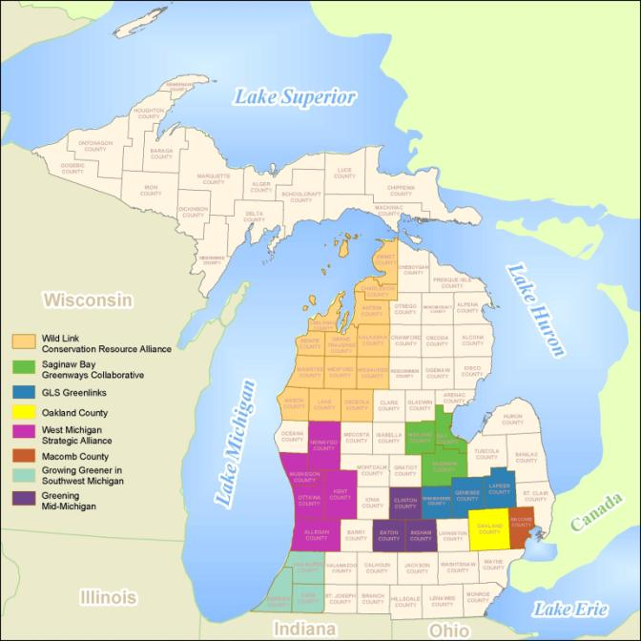
HRWC
Notes:
In 2009 Oakland County completed a nationally-recognized Green Infrastructure Vision that identifies habitat “hubs”, “sites” and “corridors” that are important to the sustainability of Oakland County’s environmental quality, ecological diversity and economy. The multi-scale Vision not only provides a basis for the overall interconnected system of open spaces and recreation, but encourages the integration of best land management practices into the local project design.
Note:
The Conservation Fund, a national nonprofit dedicated to conservation, selected Oakland County’s vision for its National Green Infrastructure Implementation Award in February, 2011
Oakland County Economic Development & Community Affairs provides Green Infrastructure capacity building assistance to local governments, businesses, work groups, and individual citizens in both urban and rural areas.

Slide 43
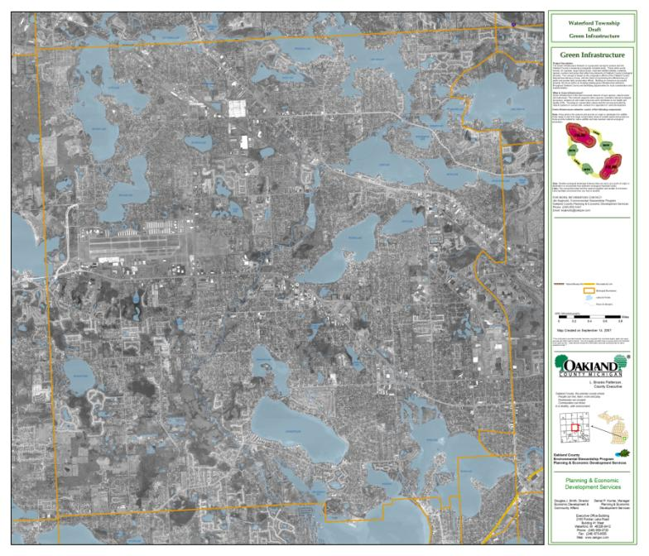
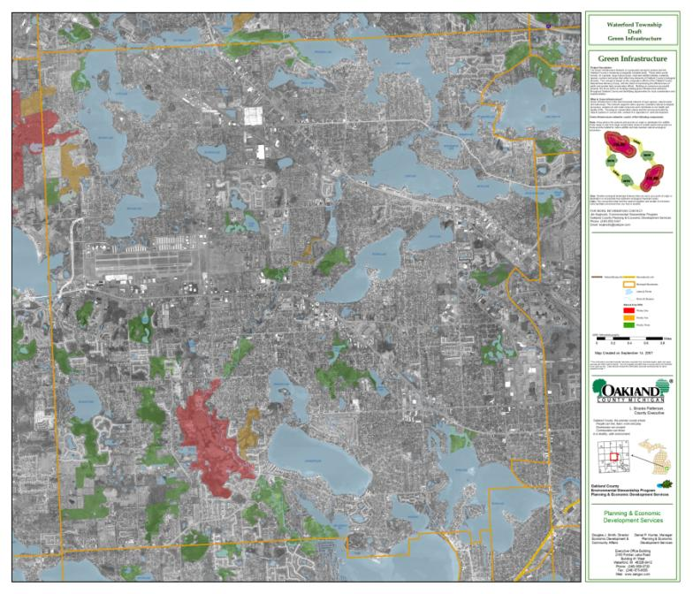


Slide 44


Slide 45


Slide 46


Example

Slide 47
Example
Land Acquisition
Lake
Buffer
Land Trust
Conservation
Easements
Open Space
Clustering
Lake
Buffer
Land
Donation
Parks
Trail Links
Native
Landscaping
Interpretive/Educational Signage
Natural Beauty Road
Designation

Slide 48













Rain Garden
Green Roof
Vegetated Swales
Riparian Buffers
Floodplains
Parks
Riparian Buffers
Pocket Wetlands
In urban environments, green infrastructure includes green roofs, trees, rain gardens, vegetated swales, pocket wetlands, parks, riparian buffers, no-mow zones, floodplains and strategically placed forested areas.
Wild Corners Program

Slide 49

Using the Green Infrastructure Vision
Conservancy Coordination
Wetland Mitigation
Recreation Plan
Grant Support
Park Acquisition Target
Grant Support
Open-Space Millage
Master Plan
Park Acquisition Target
Partnership
Building - Collaboration
Master Plan
Grant Support
Promote
no-mow zones
Promote
Native/Natural Landscaping

Slide 50


